Slide 1
3-4 TRANSMISSION IMPAIRMENT
Signals travel through transmission media, which are not perfect. The imperfection causes signal impairment. This means that the signal at the beginning of the medium is not the same as the signal at the end of the medium. What is sent is not what is received. Three causes of impairment are attenuation, distortion, and noise.
Topics discussed in this section:
Attenuation
Distortion
Noise
3.<number>

Slide 2

Figure 3.25 Causes of impairment
3.<number>

Slide 3
Transmission Impairments
Signal received may differ from signal transmitted
Analog - degradation of signal quality
Digital - bit errors
Caused by
  Attenuation
  Distortion
  Noise
3.<number>

Slide 4


Attenuation
Attenuation means a loss of energy: signal strength falls off with distance
3.<number>

Slide 5
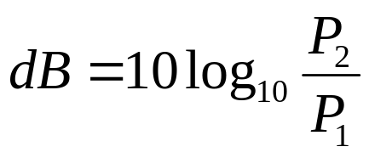
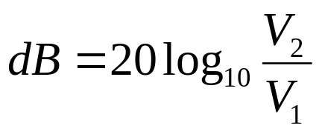
Measurement of attenuation
The decibel (dB) measures the relative strengths
of two signals or one signal at two different points.
The decibel is negative if a signal is attenuated and
positive if a signal is amplified.
Where P1 and P2 are the powers of a signal at points 1 and 2.
P = V**2/R, so
3.<number>

Slide 6

Example 3.26
Suppose a signal travels through a transmission medium and its power is reduced to one-half. This means that P2 is (1/2)P1. In this case, the attenuation (loss of power) can be calculated as
A loss of 3 dB (–3 dB) is equivalent to losing one-half the power.
3.<number>

Slide 7

Example 3.27
A signal travels through an amplifier, and its power is increased 10 times. This means that P₂ = 10P₁ . In this case, the amplification (gain of power) can be calculated as?
3.<number>

Slide 8

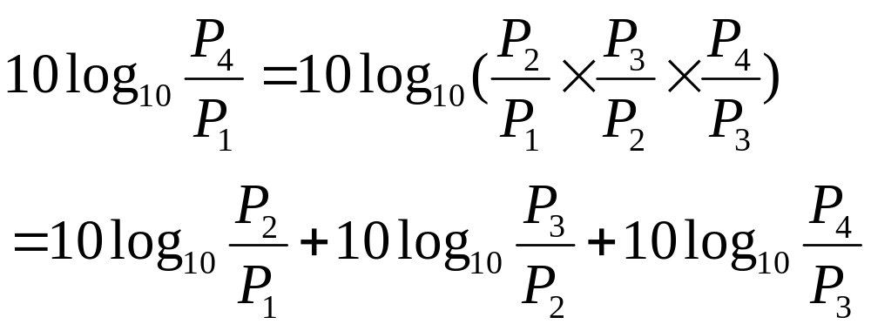
Example 3.28
One reason that engineers use the decibel to measure the changes in the strength of a signal is that decibel numbers can be added (or subtracted) when we are measuring several points (cascading) instead of just two.
3.<number>

Slide 9
Example 3.29
Sometimes the decibel is used to measure signal power in milliwatts. In this case, it is referred to as dB_{m} and is calculated as dB_{m} = 10 log₁₀ P_{m} , where P_{m} is the power in milliwatts. Calculate the power of a signal with dB_{m} = −30.
3.<number>

Slide 10

Example 3.30
The loss in a cable is usually defined in decibels per kilometer (dB/km). If the signal at the beginning of a cable with −0.3 dB/km has a power of 2 mW, what is the power of the signal at 5 km?
Solution
The loss in the cable in decibels is 5 × (−0.3) = −1.5 dB. We can calculate the power as
3.<number>

Slide 11
Distortion
Distortion means the signal changes its form or shape.
3.<number>

Slide 12
Distortion
Distortion can occur in a composite signal made of different frequencies.
Propagation velocity varies with frequency
Difference in delay creates difference in phase and hence distortion.
3.<number>

Slide 13

Figure 3.28 Distortion
3.<number>

Slide 14
Noise
Thermal noise
Induced noise
Cross talk
Impulse noise
3.<number>

Slide 15
Thermal Noise
Due to thermal agitation of electrons in a conductor.
3.<number>

Slide 16
Thermal Noise
The noise is a function of temperature.
Uniformly distributed, also called white noise.
White Noise cannot be eliminated and limit the upper bound of communication system performance.

Slide 17
Induced Noise
Noise picked up from motors or appliances
3.<number>

Slide 18
Induced Noise
Motors or appliances act as a sending antenna.
Transmission medium acts as a receiving antenna.

Slide 19
Crosstalk
An unwanted coupling between signal paths.
3.<number>

Slide 20
Crosstalk
發生可能原因：
  Electrical coupling between near twisted pair
  Unwanted signals picked up by microwave antennas.

Slide 21
Impulse Noise
Irregular pulses or spikes
  e.g. External electromagnetic interference
3.<number>

Slide 22
Impulse Noise
Short duration
High amplitude

Slide 23

Figure 3.29 Noise
3.<number>

Slide 24
Impact of noise on transmission speed
Larger is B.W., more expensive is the facility.
All transmission channels have limited bandwidth due to noise or characteristics of medium or transmission.

Slide 25
How to get best usage of BW
Get as high a data rate as possible at a particular limit of error rate for a given bandwidth.
The greatest limit is Noise
3.<number>

Slide 26
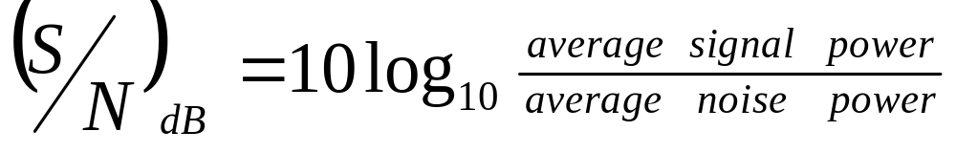
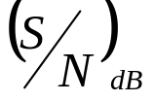
Measurement of signal quality
The ratio between signal and noise power in dB.
Large represent good signal quality.
Power ratio is based on the receiving end.

Slide 27

Figure 3.30 Two cases of SNR: a high SNR and a low SNR
3.<number>

Slide 28
Example 3.31
The power of a signal is 10 mW and the power of the noise is 1 μW; what are the values of SNR and SNR_{dB} ?
3.<number>

Slide 29
Example 3.32
The values of SNR and SNRdB for a noiseless channel are
3.<number>

